Slide 1
Automated Matrix‑Element Re‑Weighting in Effective Field Theories
Master’s Thesis
Christopher Robert Jacobsen
November 2015
Advisor: Jørgen Beck Hansen

Slide 2
Beyond Standard Physics
Hypothesis new model extending the standard model.
Compare it to experimental data.
For example, accelerator experiments, such as ATLAS or CMS at CERN.
Use Monte-Carlo event generators to create model data.
Run model data through a detector simulator.
Fit model to data.
Win Nobel prize
https://en.wikipedia.org/wiki/Standard_Model

Slide 3
What’s the problem?
Models have unknown parameters.
Determine parameters by fitting model data to experimental data.
Run model event generation and detector simulation for each new set of parameters.
Very time consuming!
1 million events:
Event generation: 10 minutes
Detector simulation: 14 days (fastest)
http://atlas.ch

Slide 4
Reweighting is one solution
Key: Event probability is a quadratic function of model parameters.
If this function is known for each event:
Can generate a single model data set.
Reweight event-distributions as function of model parameters.
Result: Fitting take seconds not days or months!

Slide 5
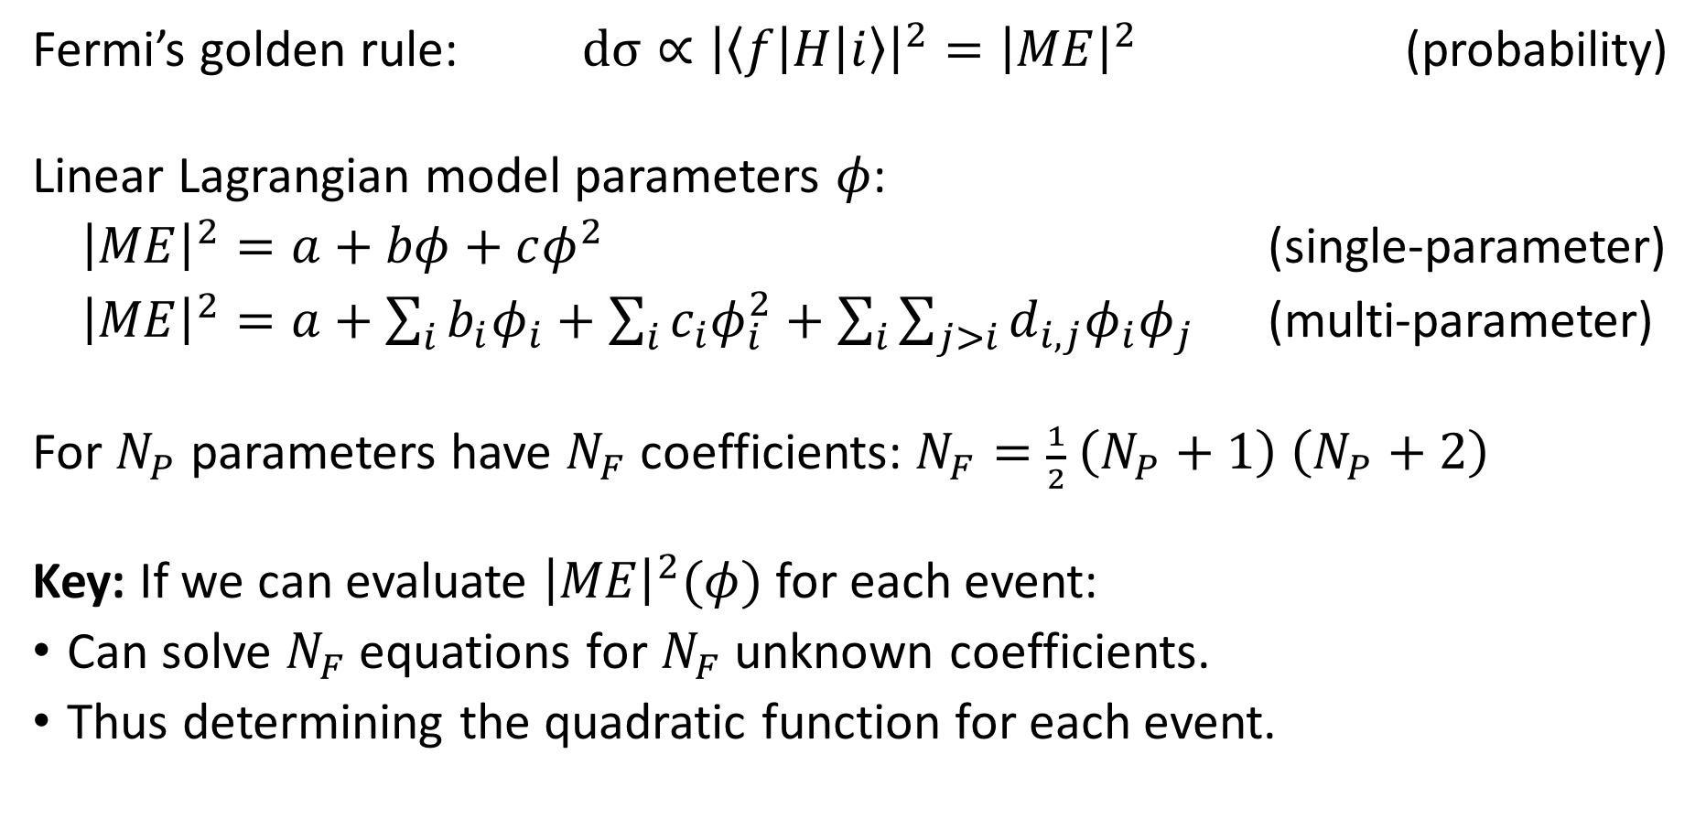
Reweighting in a nutshell
Fermi’s golden rule: $dσ∝{\left|〈f\left|H\right|i〉\right|}^{2}={\left|ME\right|}^{2}$ (probability)
Linear Lagrangian model parameters $φ$:
${\left|ME\right|}^{2}=a+bφ+cφ^{2}$ (single-parameter)
${\left|ME\right|}^{2}=a+\sum_{i}{b_{i}φ_{i}}+\sum_{i}{c_{i}φ_{i}^{2}}+\sum_{i}{\sum_{j>i}{d_{i,j}φ_{i}φ_{j}}}$ (multi-parameter)
For $N_{P}$ parameters have $N_{F}$ coefficients: $N_{F}=\frac{1}{2} \left(N_{P}+1\right) \left(N_{P}+2\right)$
Key: If we can evaluate ${\left|ME\right|}^{2}(φ)$ for each event:
Can solve $N_{F}$ equations for $N_{F}$ unknown coefficients.
Thus determining the quadratic function for each event.

Slide 6
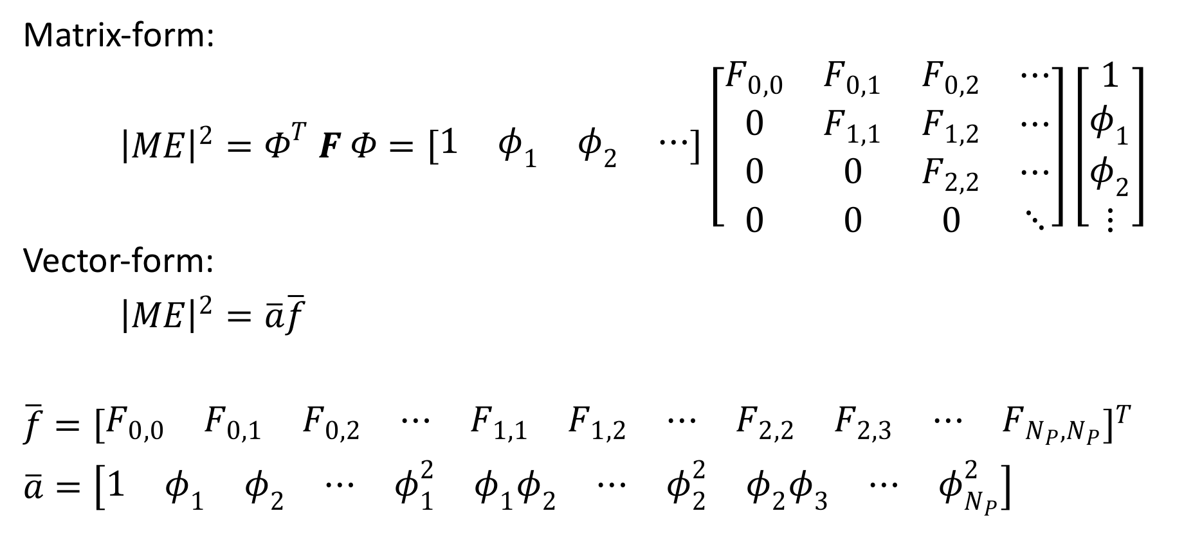
Reweighting in a nutshell …
Matrix-form:
${\left|ME\right|}^{2}=Φ^{T} F Φ=\left[\begin{matrix}1 & φ_{1} & φ_{2} & ⋯\end{matrix}\right]\left[\begin{matrix}F_{0,0} & F_{0,1} & F_{0,2} & ⋯ \\ 0 & F_{1,1} & F_{1,2} & ⋯ \\ 0 & 0 & F_{2,2} & ⋯ \\ 0 & 0 & 0 & ⋱\end{matrix}\right]\left[\begin{matrix}1 \\ φ_{1} \\ φ_{2} \\ ⋮\end{matrix}\right]$
Vector-form:
${\left|ME\right|}^{2}=\overline{a}\overline{f}$
$\overline{f}={\left[\begin{matrix}F_{0,0} & F_{0,1} & F_{0,2} & ⋯ & F_{1,1} & F_{1,2} & ⋯ & F_{2,2} & F_{2,3} & ⋯ & F_{N_{P},N_{P}}\end{matrix}\right]}^{T}$
$\overline{a}=\left[\begin{matrix}1 & φ_{1} & φ_{2} & ⋯ & φ_{1}^{2} & φ_{1}φ_{2} & ⋯ & φ_{2}^{2} & φ_{2}φ_{3} & ⋯ & φ_{N_{P}}^{2}\end{matrix}\right]$

Slide 7
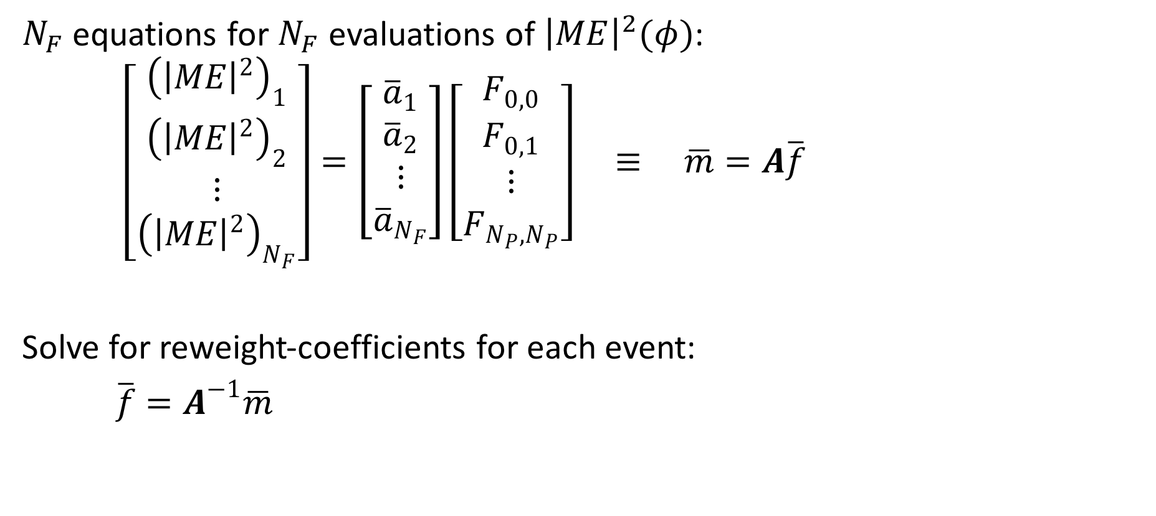
Reweighting in a nutshell …
$N_{F}$ equations for $N_{F}$ evaluations of ${\left|ME\right|}^{2}(φ)$:
$\left[\begin{matrix}{\left({\left|ME\right|}^{2}\right)}_{1} \\ {\left({\left|ME\right|}^{2}\right)}_{2} \\ ⋮ \\ {\left({\left|ME\right|}^{2}\right)}_{N_{F}}\end{matrix}\right]=\left[\begin{matrix}{\overline{a}}_{1} \\ {\overline{a}}_{2} \\ ⋮ \\ {\overline{a}}_{N_{F}}\end{matrix}\right]\left[\begin{matrix}F_{0,0} \\ F_{0,1} \\ ⋮ \\ F_{N_{P},N_{P}}\end{matrix}\right] ≡ \overline{m}=A\overline{f}$
Solve for reweight-coefficients for each event:
$\overline{f}=A^{−1}\overline{m}$

Slide 8
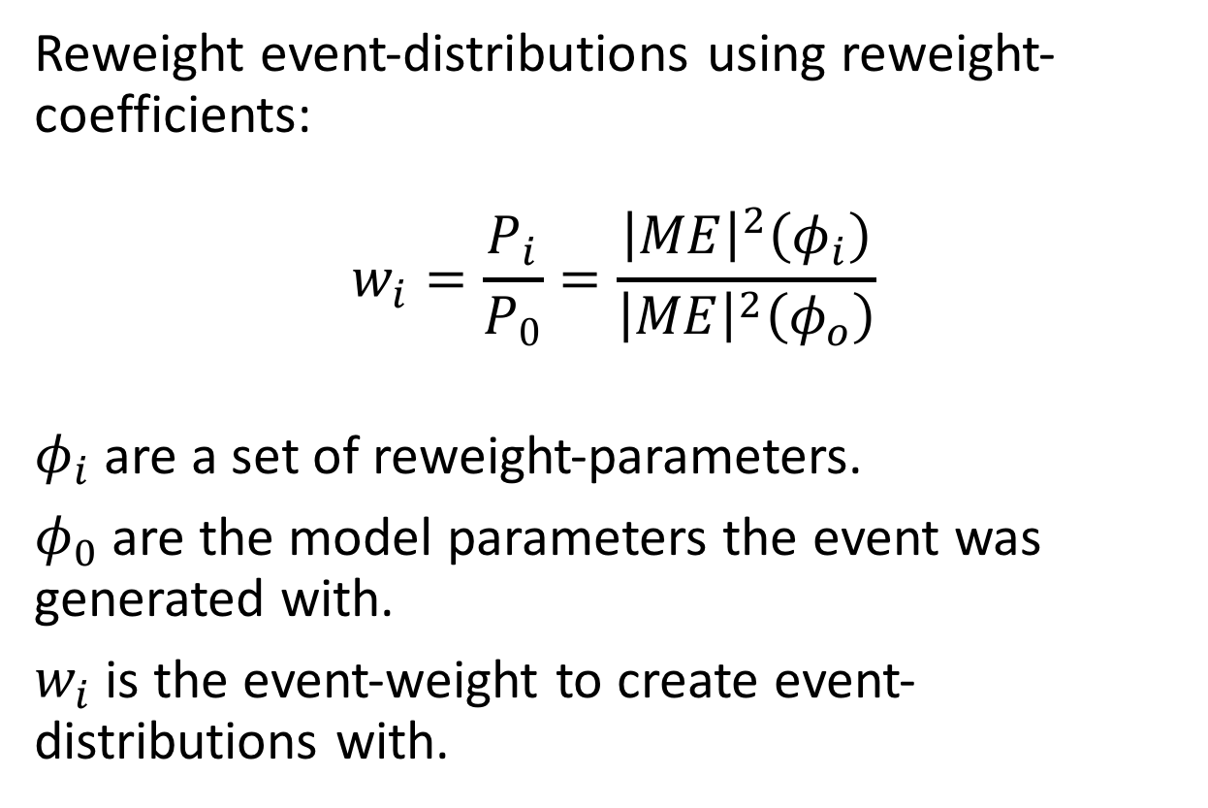
Reweighting in a nutshell …
Reweight event-distributions using reweight-coefficients:
$$w_{i}=\frac{P_{i}}{P_{0}}=\frac{{\left|ME\right|}^{2}\left(φ_{i}\right)}{{\left|ME\right|}^{2}\left(φ_{o}\right)}$$
$φ_{i}$ are a set of reweight-parameters.
$φ_{0}$ are the model parameters the event was generated with.
$w_{i}$ is the event-weight to create event-distributions with.

Slide 9
Project Purpose
Create a software tool to calculate and embed reweight-coefficients into event files, using Sherpa event generator for matrix-element evaluation.
Implement an effective field theory (EFT) model for dimension-six operators, using UFO support in Sherpa.
Test reweighting of EFT, fitting it to the SM.

Slide 10
Step 1 | SherpaWeight
Step 2 | EFT model
Step 3 | Choose process and generate events
Step 4 | Choose observables and binning
Step 5 | Test EFT model
Step 6 | Test reweighting
Step 7 | Fit EFT to SM

Slide 11
SherpaWeight – a reweighting software tool
Calculates reweight-coefficients for user-specified reweight model-parameters.
Embeds the reweight-coefficients in copy of event file.
Linked with Sherpa framework (version 2.2.0).
Supports all Sherpa and UFO models.
Supports HepMC2 and Sherpa-ROOT event files.
Generic modular design to be future extendable.
Cross-platform C++11.

Slide 12
SherpaWeight – a reweighting software tool
A problem with the Sherpa framework:
Model parameters can only be set once per instance.
Only one instance can be constructed per application.
Solution: SherpaME – a matrix-element calculation tool
Called by SherpaWeight to evaluate matrix-elements for a given set of model parameters and an event file.
Stores ME values in a ROOT data file as a tree object.

Slide 13
SherpaWeight – a reweighting software tool
ME Evaluation (1M events ~ 5minutes)
Input Event File
SherpaWeight
Iterate through ME evaluations
Calculate reweight-coefficients
Embed coefficients in copy of events
SherpaME
Initialize Sherpa
Calculate ME for each event
Input Event File
Sherpa Model Run Card (modified)
Sherpa Model Run Card
Output ME File
(SherpaWeight){
Param1 0 1E3
Param2 5.1 2.6
Block[1] 0.5 0.25
}(SherpaWeight)
Output Event File with reweight-coefficients

Slide 14
Step 1 | SherpaWeight
Step 2 | EFT model
Step 3 | Choose process and generate events
Step 4 | Choose observables and binning
Step 5 | Test EFT model
Step 6 | Test reweighting
Step 7 | Fit EFT to SM

Slide 15
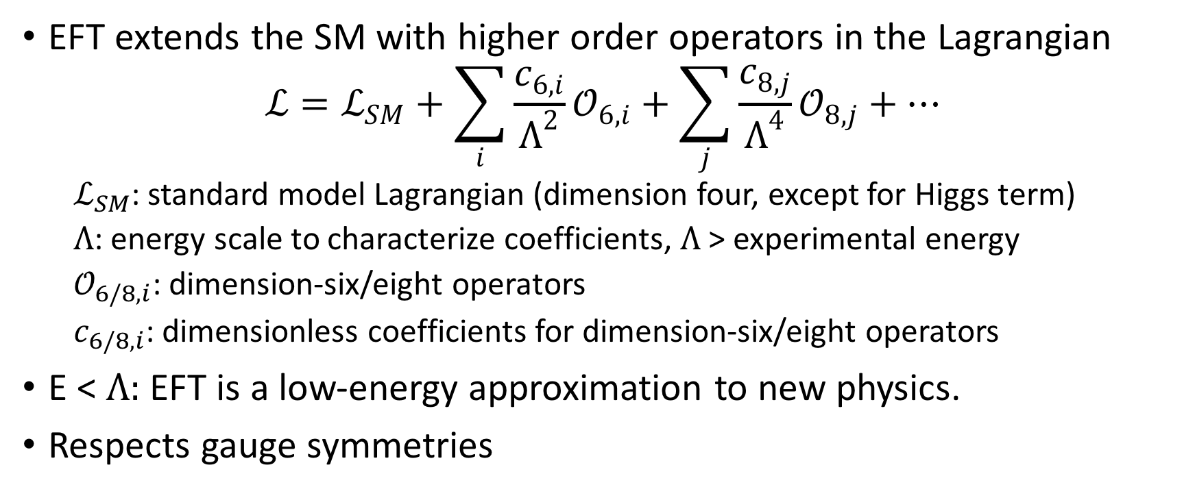
Effective Field Theory (EFT)
EFT extends the SM with higher order operators in the Lagrangian
$$ℒ=ℒ_{SM}+\sum_{i}{\frac{c_{6,i}}{Λ^{2}}}𝒪_{6,i}+\sum_{j}{\frac{c_{8,j}}{Λ^{4}}}𝒪_{8,j}+…$$
$ℒ_{SM}$: standard model Lagrangian (dimension four, except for Higgs term)
$Λ$: energy scale to characterize coefficients, $Λ$ > experimental energy
$𝒪_{6/8,i}$: dimension-six/eight operators
$c_{6/8,i}$: dimensionless coefficients for dimension-six/eight operators
E < $Λ:$ EFT is a low-energy approximation to new physics.
Respects gauge symmetries

Slide 16
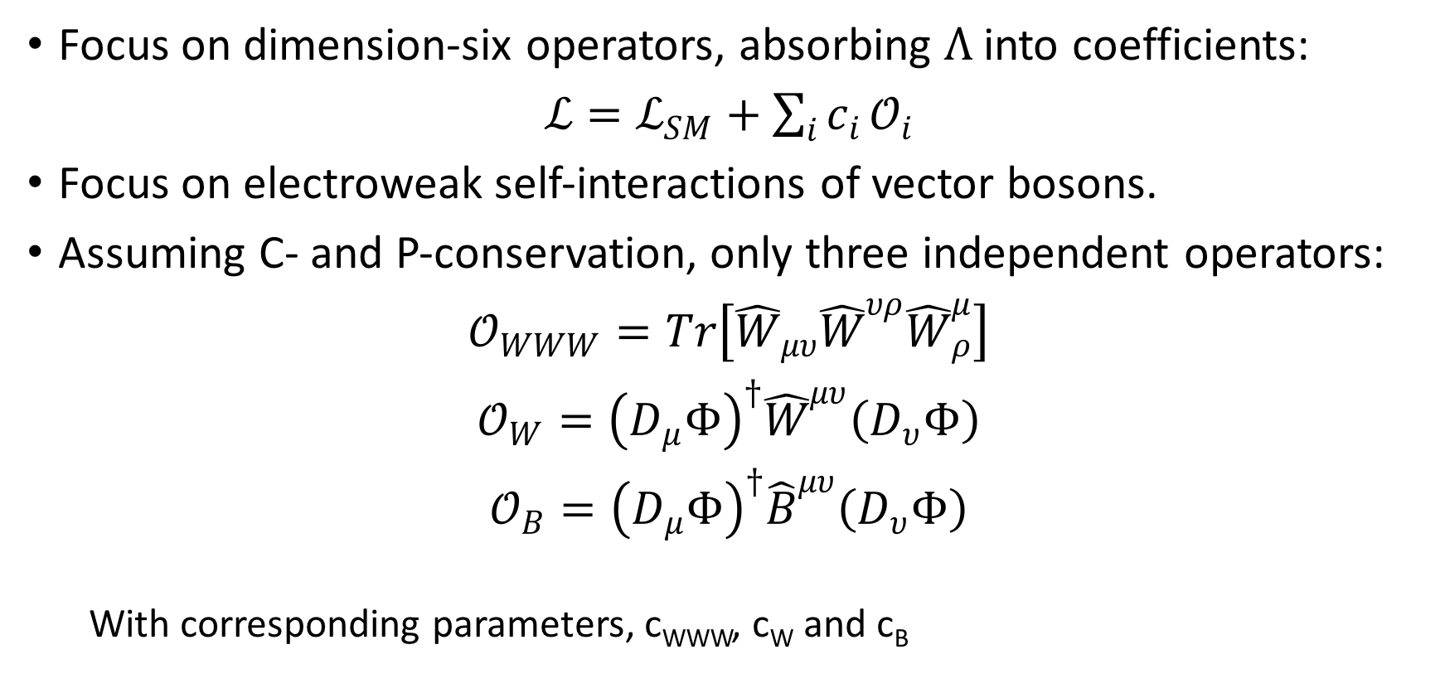
EFT – Dimension six operators
Focus on dimension-six operators, absorbing $Λ$ into coefficients:
$ℒ=ℒ_{SM}+\sum_{i}{c_{i}}𝒪_{i}$
Focus on electroweak self-interactions of vector bosons.
Assuming C- and P-conservation, only three independent operators:
$𝒪_{WWW}=Tr\left[{\hat{W}}_{μυ}{\hat{W}}^{υρ}{\hat{W}}_{ρ}^{μ}\right]$
$𝒪_{W}={\left(D_{μ}Φ\right)}^{†}{\hat{W}}^{μυ}\left(D_{υ}Φ\right)$
$𝒪_{B}={\left(D_{μ}Φ\right)}^{†}{\hat{B}}^{μυ}\left(D_{υ}Φ\right)$
With corresponding parameters, c_{WWW}, c_{W} and c_{B}

Slide 17
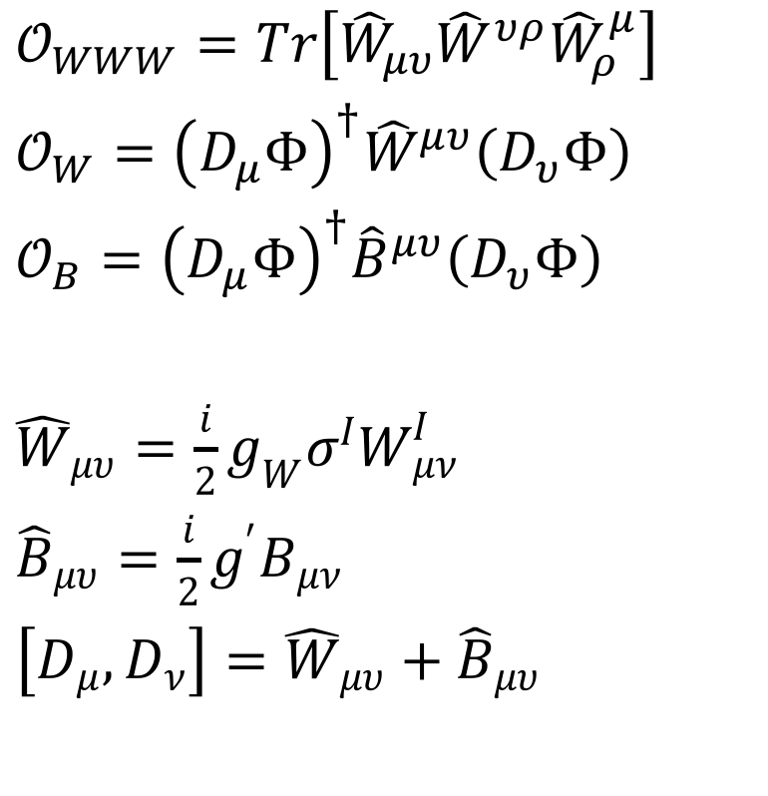
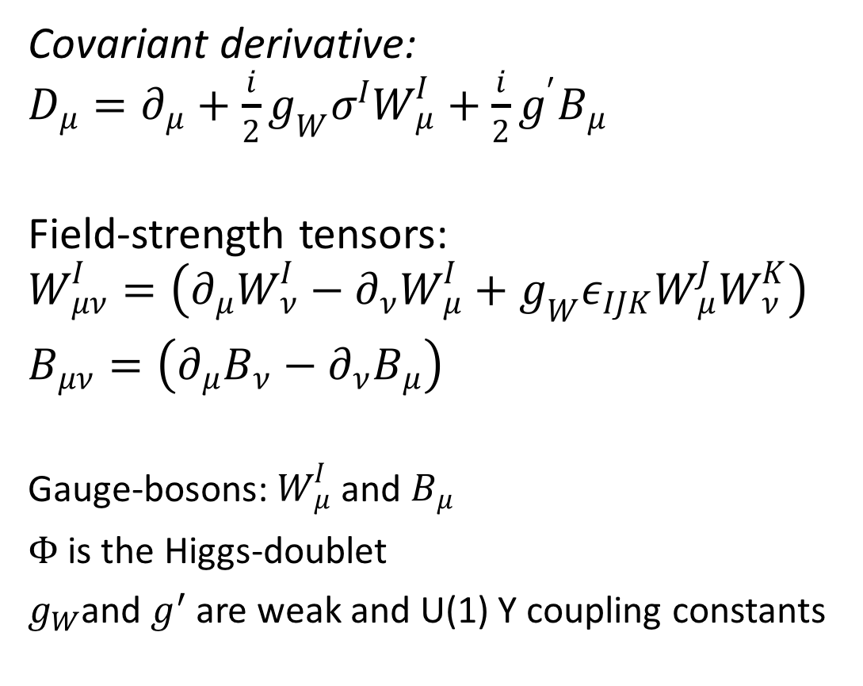
EFT – Dimension six operators
Covariant derivative: $D_{μ}=∂_{μ}+\frac{i}{2}g_{W}σ^{I}W_{μ}^{I}+\frac{i}{2}g^{′}B_{μ}$
Field-strength tensors: $W_{μν}^{I}=\left(∂_{μ}W_{ν}^{I}−∂_{ν}W_{μ}^{I}+g_{W}ε_{IJK}W_{μ}^{J}W_{ν}^{K}\right)$
$B_{μν}=\left(∂_{μ}B_{ν}−∂_{ν}B_{μ}\right)$
Gauge-bosons: $W_{μ}^{I}$ and $B_{μ}$
$Φ$ is the Higgs-doublet
$g_{W}$and $g^{′}$ are weak and U(1) Y coupling constants
$𝒪_{WWW}=Tr\left[{\hat{W}}_{μυ}{\hat{W}}^{υρ}{\hat{W}}_{ρ}^{μ}\right]$
$𝒪_{W}={\left(D_{μ}Φ\right)}^{†}{\hat{W}}^{μυ}\left(D_{υ}Φ\right)$
$𝒪_{B}={\left(D_{μ}Φ\right)}^{†}{\hat{B}}^{μυ}\left(D_{υ}Φ\right)$
${\hat{W}}_{μυ}=\frac{i}{2}g_{W}σ^{I}W_{μν}^{I}$
${\hat{B}}_{μυ}=\frac{i}{2}g^{′}B_{μν}$
$\left[D_{μ},D_{ν}\right]={\hat{W}}_{μυ}+{\hat{B}}_{μυ}$

Slide 18
From EFT to UFO model
Define an EFT Lagrangian using FeynRules
Export a UFO SM+EFT model
LOD6 := Block[{mu,nu,rho,ii,jj,kk,Bhat,What},
What[mu_,nu_,ii_,jj_] := Module[{aa}, -I/2 gw PauliSigma[aa,ii,jj]
FS[Wi,mu,nu,aa]];
Bhat[mu_,nu_] := -I/2 g1 FS[B,mu,nu];
ExpandIndices[
ocWWW What[mu,nu,ii,jj] What[nu,rho,jj,kk] What[rho,mu,kk,ii] +
ocW DC[Phibar[ii],mu] What[mu,nu,ii,jj] DC[Phi[jj],nu] +
ocB DC[Phibar[ii],mu] Bhat[mu,nu] DC[Phi[ii],nu]
,FlavorExpand->True] ];

Slide 19
Step 1 | SherpaWeight
Step 2 | EFT model
Step 3 | Choose process and generate events
Step 4 | Choose observables and binning
Step 5 | Test EFT model
Step 6 | Test reweighting
Step 7 | Fit EFT to SM

Slide 20
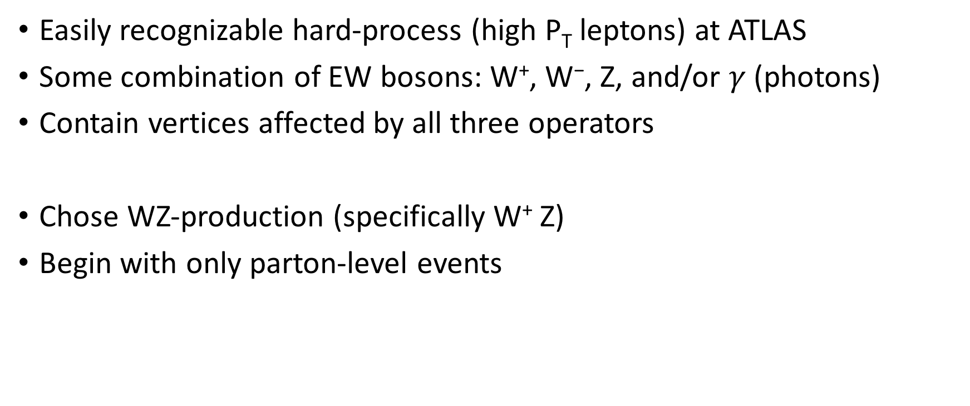
Choice of Process
Easily recognizable hard-process (high P_{T} leptons) at ATLAS
Some combination of EW bosons: W⁺, W⁻, Z, and/or $γ$ (photons)
Contain vertices affected by all three operators
Chose WZ-production (specifically W⁺ Z)
Begin with only parton-level events

Slide 21
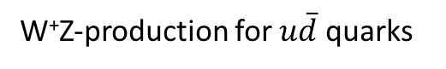
W⁺Z-production
W⁺Z-production for $u\overline{d}$ quarks

Slide 22
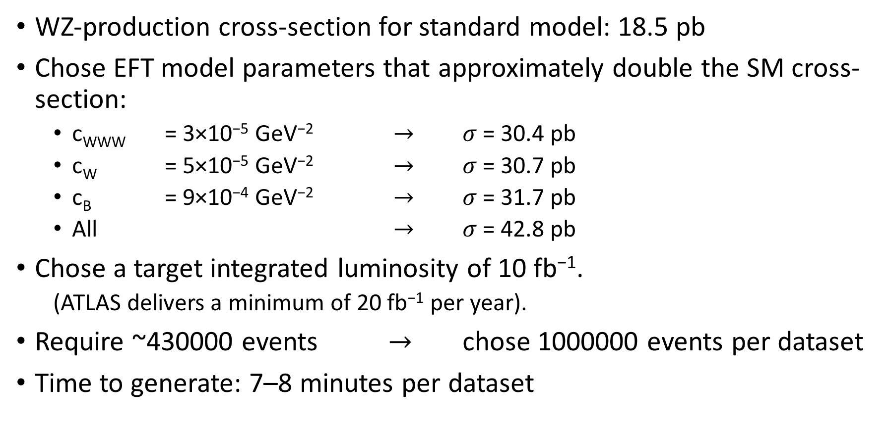
Choice of Event Generation
WZ-production cross-section for standard model: 18.5 pb
Chose EFT model parameters that approximately double the SM cross-section:
c_{WWW} = 3×10⁻⁵ GeV⁻² $→$ $σ$ = 30.4 pb
c_{W} = 5×10⁻⁵ GeV⁻² $→$ $σ$ = 30.7 pb
c_{B} = 9×10⁻⁴ GeV⁻² $→$ $σ$ = 31.7 pb
All $→$ $σ$ = 42.8 pb
Chose a target integrated luminosity of 10 fb⁻¹.
(ATLAS delivers a minimum of 20 fb⁻¹ per year).
Require ~430000 events $→$ chose 1000000 events per dataset
Time to generate: 7–8 minutes per dataset

Slide 23
Step 1 | SherpaWeight
Step 2 | EFT model
Step 3 | Choose process and generate events
Step 4 | Choose observables and binning
Step 5 | Test EFT model
Step 6 | Test reweighting
Step 7 | Fit EFT to SM

Slide 24
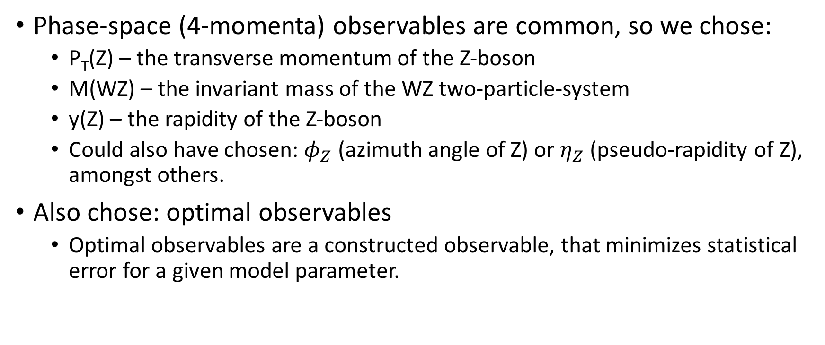
Choice of Observables
Phase-space (4-momenta) observables are common, so we chose:
P_{T}(Z) – the transverse momentum of the Z-boson
M(WZ) – the invariant mass of the WZ two-particle-system
y(Z) – the rapidity of the Z-boson
Could also have chosen: $φ_{Z}$ (azimuth angle of Z) or $η_{Z}$ (pseudo-rapidity of Z), amongst others.
Also chose: optimal observables
Optimal observables are a constructed observable, that minimizes statistical error for a given model parameter.

Slide 25
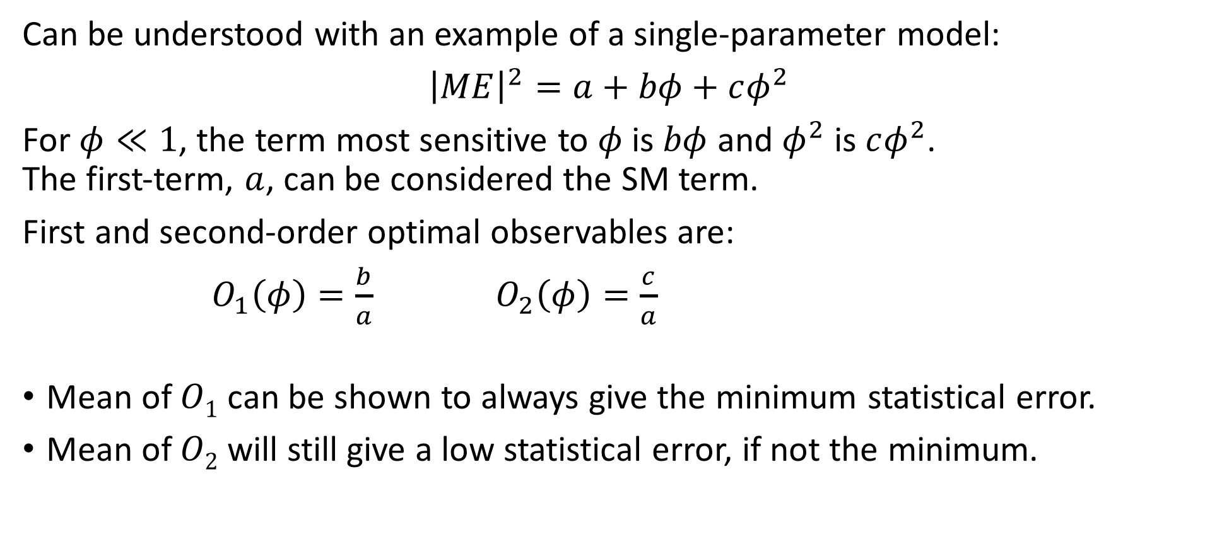
Optimal Observables
Can be understood with an example of a single-parameter model:
${\left|ME\right|}^{2}=a+bφ+cφ^{2}$
For $φ≪1$, the term most sensitive to $φ$ is $bφ$ and $φ^{2}$ is $cφ^{2}$. The first-term, $a$, can be considered the SM term.
First and second-order optimal observables are:
$O_{1}\left(φ\right)=\frac{b}{a}$ $O_{2}\left(φ\right)=\frac{c}{a}$
Mean of $O1$ can be shown to always give the minimum statistical error.
Mean of $O2$ will still give a low statistical error, if not the minimum.

Slide 26
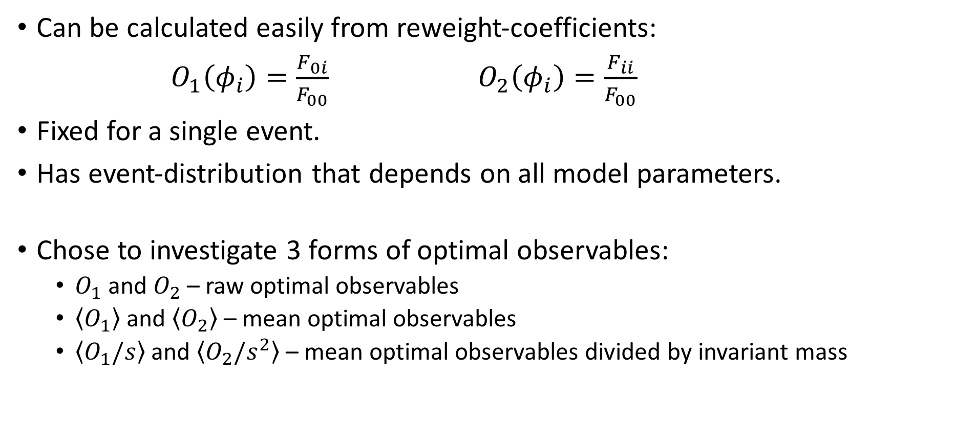
Optimal Observables
Can be calculated easily from reweight-coefficients:
$O_{1}\left(φ_{i}\right)=\frac{F_{0i}}{F_{00}}$ $O_{2}\left(φ_{i}\right)=\frac{F_{ii}}{F_{00}}$
Fixed for a single event.
Has event-distribution that depends on all model parameters.
Chose to investigate 3 forms of optimal observables:
$O_{1}$ and $O_{2}$ – raw optimal observables
$\left\langle O_{1}\right\rangle$ and $\left\langle O_{2}\right\rangle$ – mean optimal observables
$\left\langle O_{1}/s\right\rangle$ and $\left\langle O_{2}/s^{2}\right\rangle$ – mean optimal observables divided by invariant mass

Slide 27
Choice of Binning and Data Range
To avoid having long sparse data tails, dataset ranges were allowed to exclude up to 10 events at 10 fb⁻¹.
Equal bin-widths were chosen for simplicity.
Number of bins was selected after minimizing a bin-optimization function, called cross-validation.

Slide 28
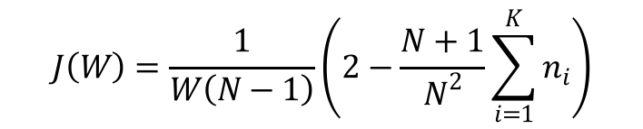
Bin Optimization using Cross-Validation
$$J\left(W\right)=\frac{1}{W\left(N−1\right)}\left(2−\frac{N+1}{N^{2}}\sum_{i=1}^{K}{n_{i}}\right)$$
Cross-validation minimization objective for M(WZ)
Cross-validation minimization objective for O₂(c_{W})

Slide 29
Step 1 | SherpaWeight
Step 2 | EFT model
Step 3 | Choose process and generate events
Step 4 | Choose observables and binning
Step 5 | Test EFT model
Step 6 | Test reweighting
Step 7 | Fit EFT to SM

Slide 30
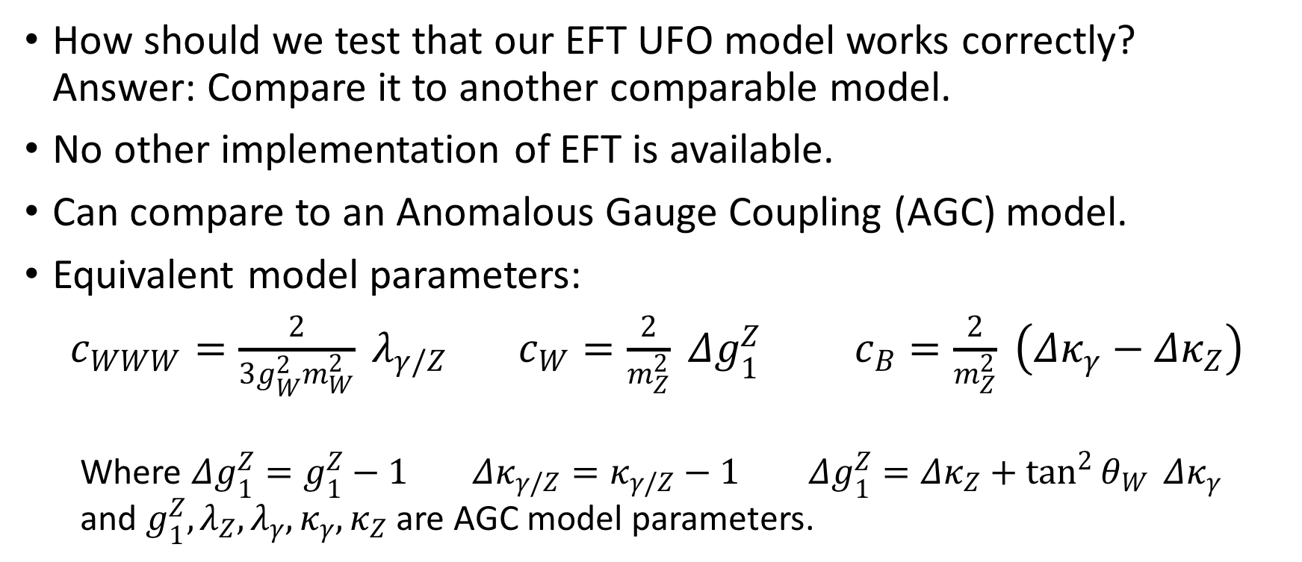
Test EFT model – Compare EFT to AGC
How should we test that our EFT UFO model works correctly? Answer: Compare it to another comparable model.
No other implementation of EFT is available.
Can compare to an Anomalous Gauge Coupling (AGC) model.
Equivalent model parameters:
$c_{WWW}=\frac{2}{3g_{W}^{2}m_{W}^{2}} λ_{γ/Z}$ $c_{W}=\frac{2}{m_{Z}^{2}} Δg_{1}^{Z}$ $c_{B}=\frac{2}{m_{Z}^{2}} \left(Δκ_{γ}−Δκ_{Z}\right)$
Where $Δg_{1}^{Z}=g_{1}^{Z}−1$ $Δκ_{γ/Z}=κ_{γ/Z}−1$ $Δg_{1}^{Z}=Δκ_{Z}+\tan^{2}{θ_{W}} Δκ_{γ}$ and $g_{1}^{Z}, λ_{Z}, λ_{γ}, κ_{γ}, κ_{Z}$ are AGC model parameters.

Slide 31
Compare EFT to AGC – Example Results
Comparison of equivalent EFT to AGC for P_{T}(Z) for parton-level WZ-production at 10 fb⁻¹.
Circled bins have less then 10 entries (non-scaled) and are excluded from statistics.
Comparison of equivalent EFT to AGC for y(Z) for parton-level WZ-production at 10 fb⁻¹.
Circled bins have less then 10 entries (non-scaled) and are excluded from statistics.

Slide 32
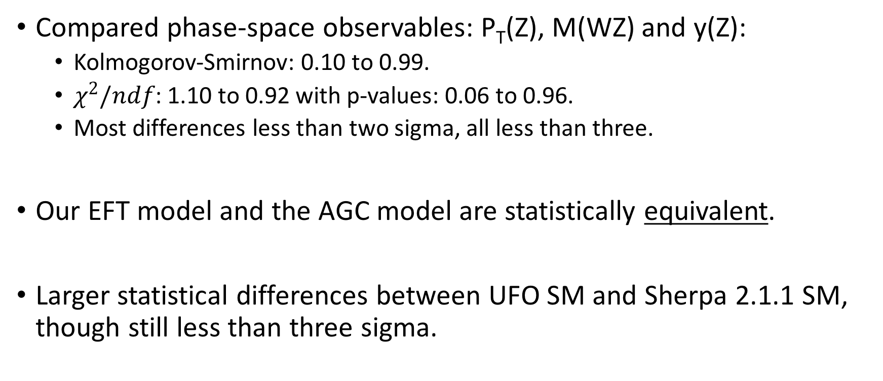
Compare EFT to AGC – Conclusion
Compared phase-space observables: P_{T}(Z), M(WZ) and y(Z):
Kolmogorov-Smirnov: 0.10 to 0.99.
$χ^{2}/ndf$: 1.10 to 0.92 with p-values: 0.06 to 0.96.
Most differences less than two sigma, all less than three.
Our EFT model and the AGC model are statistically equivalent.
Larger statistical differences between UFO SM and Sherpa 2.1.1 SM, though still less than three sigma.

Slide 33
Step 1 | SherpaWeight
Step 2 | EFT model
Step 3 | Choose process and generate events
Step 4 | Choose observables and binning
Step 5 | Test EFT model
Step 6 | Test reweighting
Step 7 | Fit EFT to SM

Slide 34
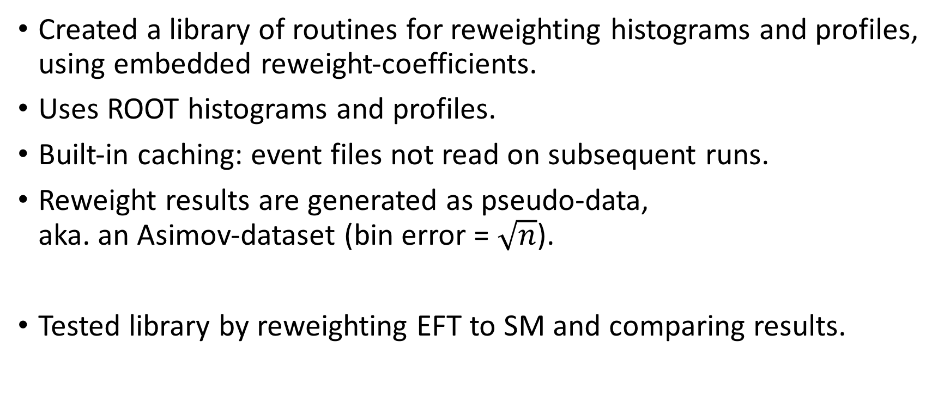
Testing Reweighting
Created a library of routines for reweighting histograms and profiles, using embedded reweight-coefficients.
Uses ROOT histograms and profiles.
Built-in caching: event files not read on subsequent runs.
Reweight results are generated as pseudo-data, aka. an Asimov-dataset (bin error = $\sqrt{n}$).
Tested library by reweighting EFT to SM and comparing results.

Slide 35
Testing Reweighting – Example Results
Comparison of reweighted-EFT to SM for P_{T}(Z) for parton-level WZ-production at 10 fb⁻¹.
Circled bins have less then 10 entries (non-scaled) and are excluded from statistics.
Comparison of reweighted-EFT to SM for y(Z) for parton-level WZ-production at 10 fb⁻¹.
Circled bins have less then 10 entries (non-scaled) and are excluded from statistics.

Slide 36
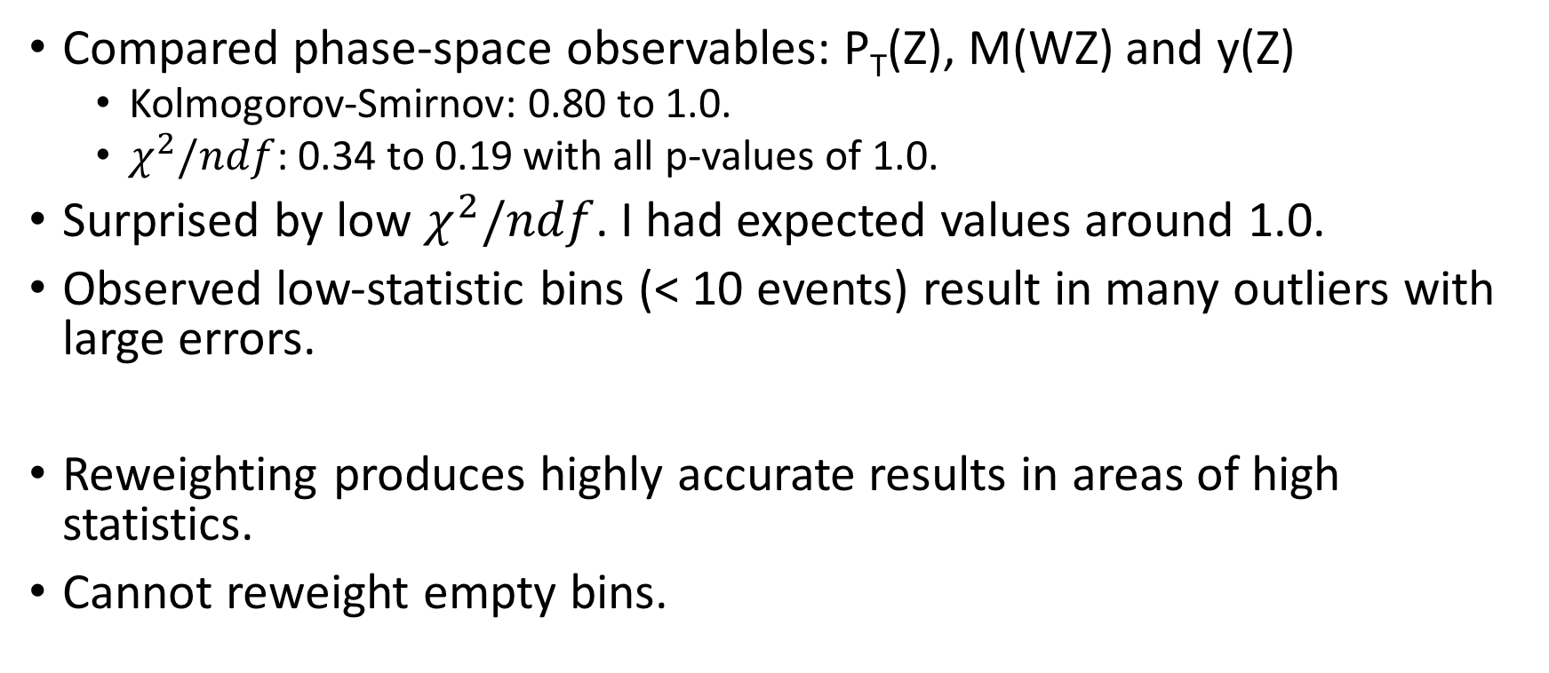
Testing Reweighting – Conclusions
Compared phase-space observables: P_{T}(Z), M(WZ) and y(Z)
Kolmogorov-Smirnov: 0.80 to 1.0.
$χ^{2}/ndf$: 0.34 to 0.19 with all p-values of 1.0.
Surprised by low $χ^{2}/ndf$. I had expected values around 1.0.
Observed low-statistic bins (< 10 events) result in many outliers with large errors.
Reweighting produces highly accurate results in areas of high statistics.
Cannot reweight empty bins.

Slide 37
Step 1 | SherpaWeight
Step 2 | EFT model
Step 3 | Choose process and generate events
Step 4 | Choose observables and binning
Step 5 | Test EFT model
Step 6 | Test reweighting
Step 7 | Fit EFT to SM

Slide 38
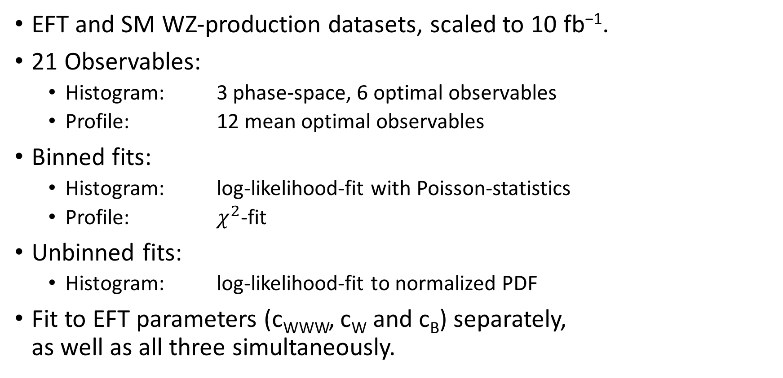
Fitting EFT to SM
EFT and SM WZ-production datasets, scaled to 10 fb⁻¹.
21 Observables:
Histogram: 3 phase-space, 6 optimal observables
Profile: 12 mean optimal observables
Binned fits:
Histogram: log-likelihood-fit with Poisson-statistics
Profile: $χ^{2}$-fit
Unbinned fits:
Histogram: log-likelihood-fit to normalized PDF
Fit to EFT parameters (c_{WWW}, c_{W} and c_{B}) separately, as well as all three simultaneously.

Slide 39
Fitting – General Results
Fitting all parameters simultaneously gave higher confidence limits.
Fit results for mean optimal observables were the same as the mean optimal observable divided by the invariant mass.
Execution time:
Binned fit: ca. 0.25 seconds
Unbinned fit: ca. 30 seconds

Slide 40
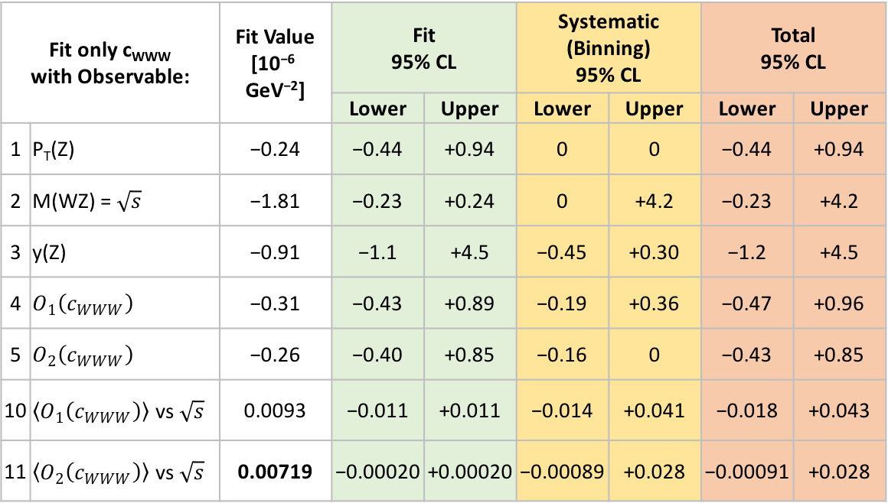
Binned Fits – Results
Lowest confidence limits: mean optimal observables
c_{WWW}: ca. 2×10⁻⁸
c_{W}: ca. 3×10⁻⁸
c_{B} ca. 2×10⁻⁶
Systematic errors from binning were on par with statistical errors.
M(WZ) and mean optimal observables generally had confidence limits outside of zero
Selection of binned fit results for c_{WWW}.
Fit only c_{WWW} with Observable: |  | Fit Value [10⁻⁶ GeV⁻²] | Fit 95% CL |  | Systematic (Binning) 95% CL |  | Total 95% CL
 |  |  | Lower | Upper | Lower | Upper | Lower | Upper
1 | P_{T}(Z) | −0.24 | −0.44 | +0.94 | 0 | 0 | −0.44 | +0.94
2 | M(WZ) = $\sqrt{s}$ | −1.81 | −0.23 | +0.24 | 0 | +4.2 | −0.23 | +4.2
3 | y(Z) | −0.91 | −1.1 | +4.5 | −0.45 | +0.30 | −1.2 | +4.5
4 | $O_{1}\left(c_{WWW}\right)$ | −0.31 | −0.43 | +0.89 | −0.19 | +0.36 | −0.47 | +0.96
5 | $O_{2}\left(c_{WWW}\right)$ | −0.26 | −0.40 | +0.85 | −0.16 | 0 | −0.43 | +0.85
10 | $〈O_{1}\left(c_{WWW}\right)〉$ vs $\sqrt{s}$ | 0.0093 | −0.011 | +0.011 | −0.014 | +0.041 | −0.018 | +0.043
11 | $〈O_{2}\left(c_{WWW}\right)〉$ vs $\sqrt{s}$ | 0.00719 | −0.00020 | +0.00020 | −0.00089 | +0.028 | −0.00091 | +0.028

Slide 41
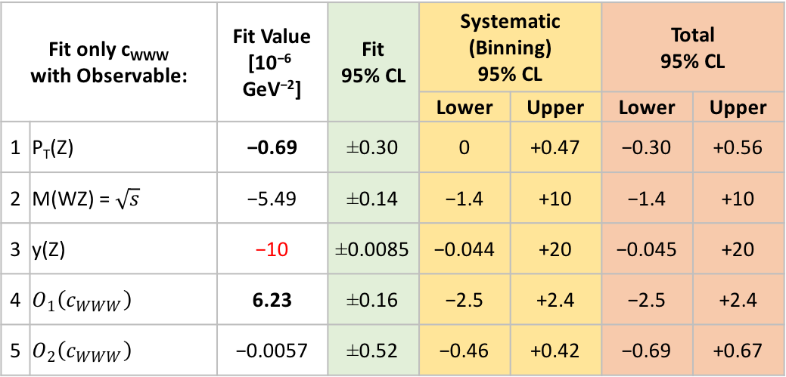
Unbinned Fits – Results
No observable had clear lowest confidence limits.
Systematic errors from binning were much higher than statistical errors.
Several fits, particularly y(Z) were bounded by fit-limits.
Selection of unbinned fit results for c_{WWW}.
Fit only c_{WWW} with Observable: |  | Fit Value [10⁻⁶ GeV⁻²] | Fit 95% CL | Systematic (Binning) 95% CL |  | Total 95% CL
 |  |  |  | Lower | Upper | Lower | Upper
1 | P_{T}(Z) | −0.69 | ±0.30 | 0 | +0.47 | −0.30 | +0.56
2 | M(WZ) = $\sqrt{s}$ | −5.49 | ±0.14 | −1.4 | +10 | −1.4 | +10
3 | y(Z) | −10 | ±0.0085 | −0.044 | +20 | −0.045 | +20
4 | $O_{1}\left(c_{WWW}\right)$ | 6.23 | ±0.16 | −2.5 | +2.4 | −2.5 | +2.4
5 | $O_{2}\left(c_{WWW}\right)$ | −0.0057 | ±0.52 | −0.46 | +0.42 | −0.69 | +0.67

Slide 42
Unbinned Fits – Example minimization scans
Minimization objective for unbinned fit of reweighted EFT to SM for MW(Z), fitting only parameter c_{WWW}.
Minimization objective for unbinned fit of reweighted EFT to SM for y(Z), fitting only parameter c_{WWW}.

Slide 43
Project Conclusions
Reweighting is cool!
Fast and accurate change to model parameters.
Allows high-speed fitting of model to data.
Reweight coefficients can be “re-used” as optimal observables.
Binning optimization is black magic.
Unbinned fits are slower and performed worse than binned fits.
M(WZ) and y(Z) observables often performed badly when fitting.
Mean optimal observables do give the lowest statistical error, but have generally higher systematic errors that can reduce the advantage.

Slide 44
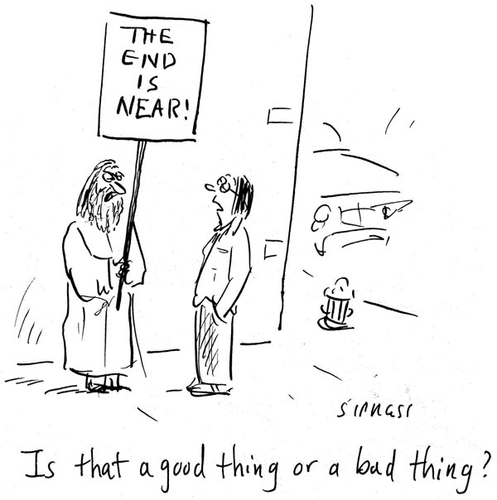
The End

Slide 45
Binned Fits – Example minimization scans
Minimization objective for binned fit of reweighted EFT to SM for P_{T}(Z), fitting only parameter c_{WWW}.
Minimization objective for binned fit of reweighted EFT to SM for M(WZ), fitting only parameter c_{WWW}.

Slide 46
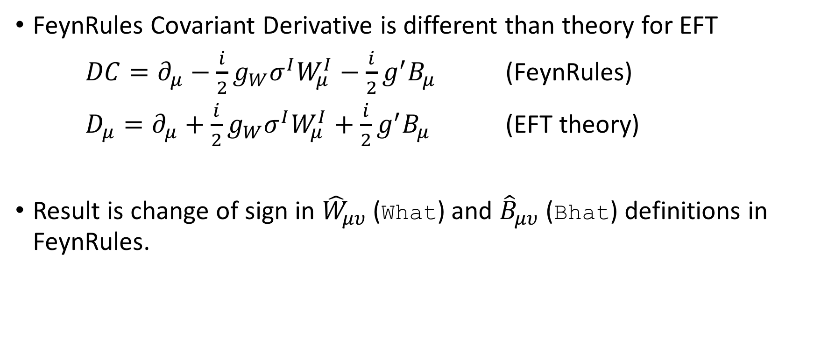
EFT – Notes on using FeynRules
FeynRules Covariant Derivative is different than theory for EFT
$DC=∂_{μ}−\frac{i}{2}g_{W}σ^{I}W_{μ}^{I}−\frac{i}{2}g^{′}B_{μ}$ (FeynRules)
$D_{μ}=∂_{μ}+\frac{i}{2}g_{W}σ^{I}W_{μ}^{I}+\frac{i}{2}g^{′}B_{μ}$ (EFT theory)
Result is change of sign in ${\hat{W}}_{μυ}$ (What) and ${\hat{B}}_{μυ}$ (Bhat) definitions in FeynRules.

